Slide 1
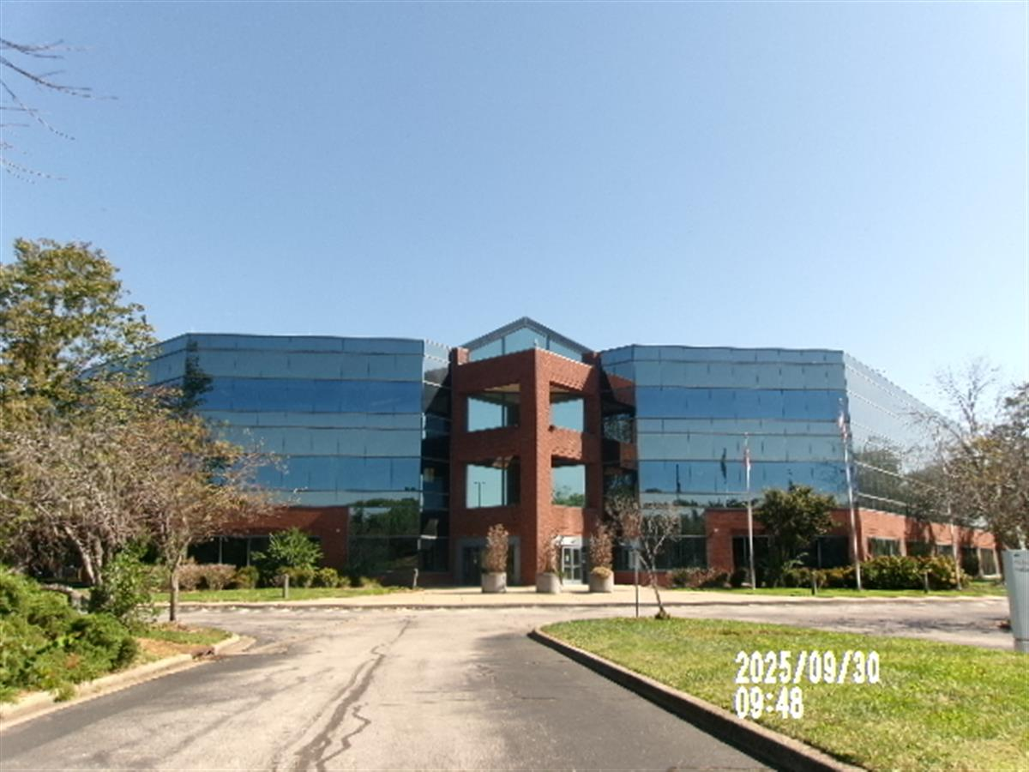
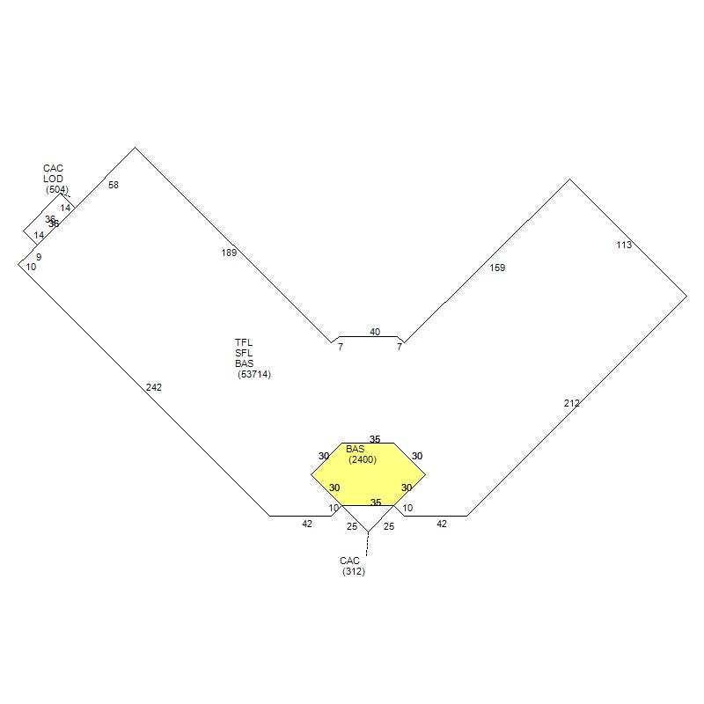
648 Grassmere Park — Comparable Sales Analysis
Subject Property | Nashville, Davidson County, TN
$25.9M
Sale Price
$115.69
Per SF
23.49 ac
Lot Size
1985
Year Built
3
Stories
IWD
Zoning
100
Comp Score
648 Grassmere Park, Nashville, TN 37211
Sale Price: $25,938,000 | Price/SF: $115.69 | Sold: 2015
Year Built: 1985 | Acreage: 23.49 ac | Stories: 3 | Zoning: IWD
Land Use: Office Building (3+ Stories) | Comp Score: 100/100

Slide 2
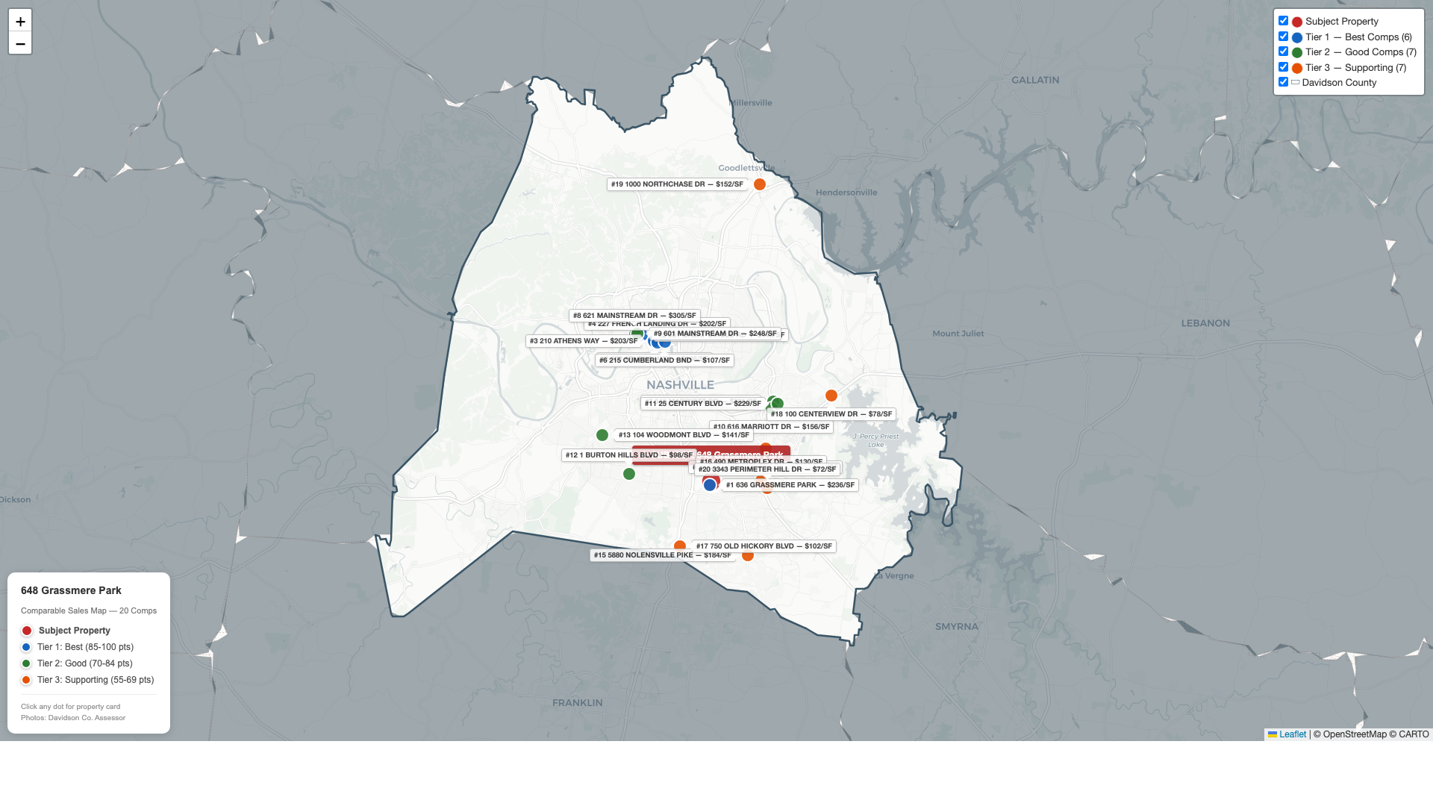
Comparable Sales Map — Davidson County, Nashville, TN
648 Grassmere Park | 20 Comparable Properties | Interactive Map: nataliebaldacci.github.io/RE_Final_Case

Slide 3
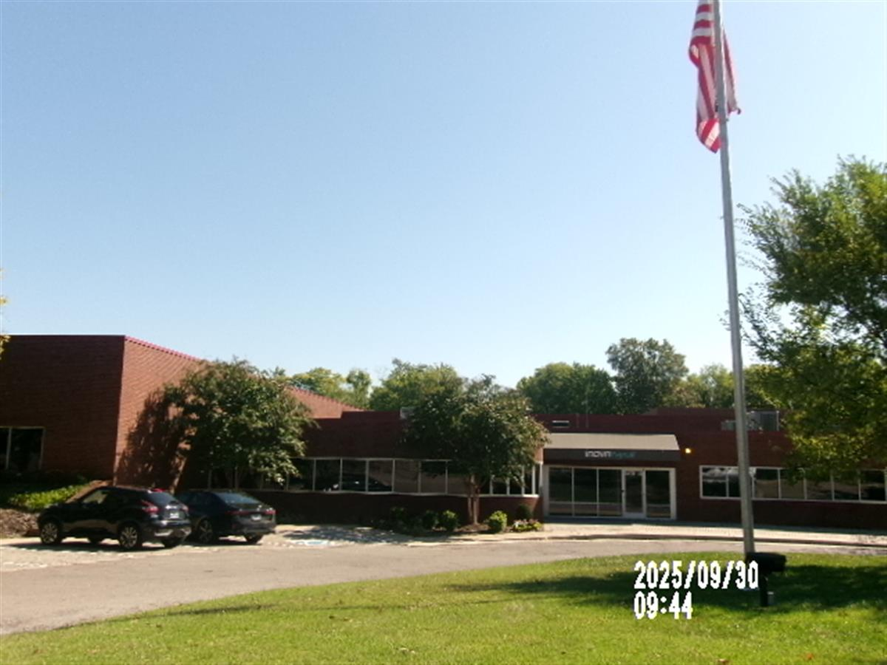
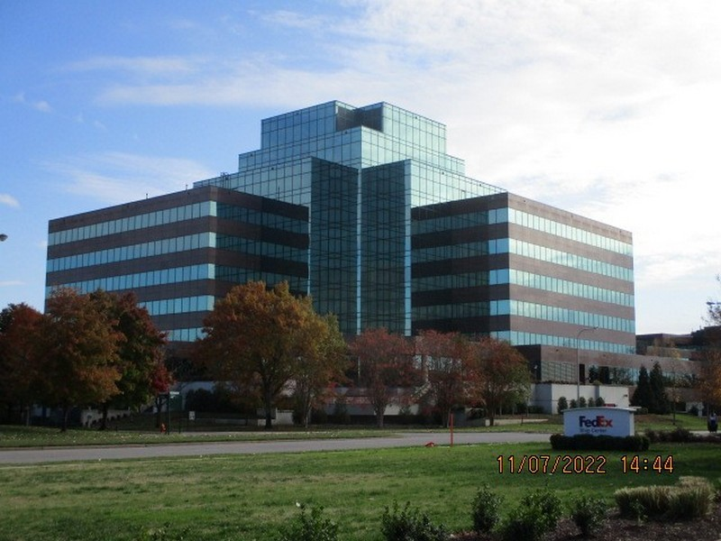
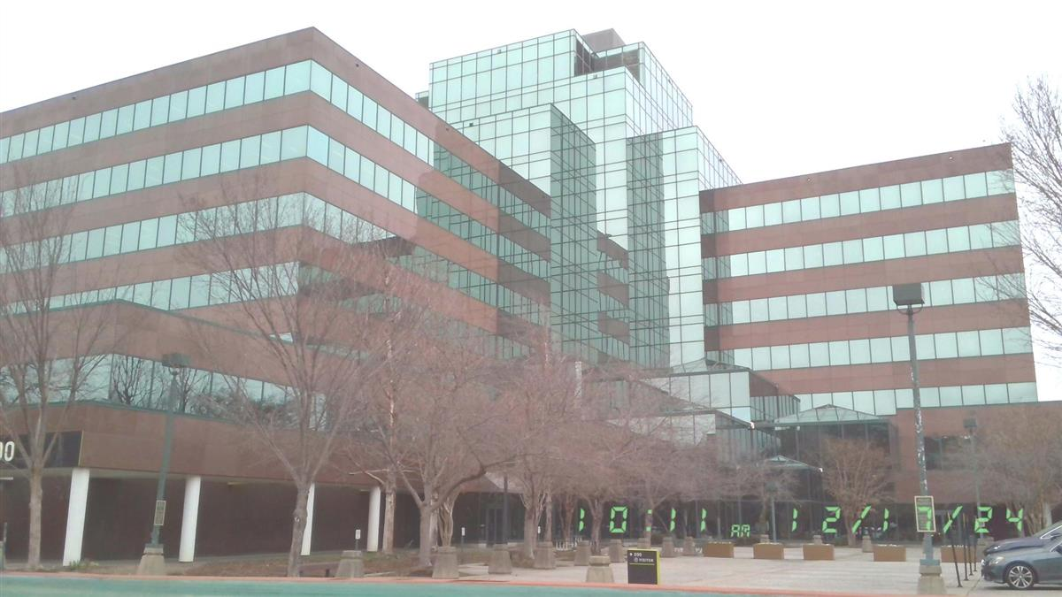
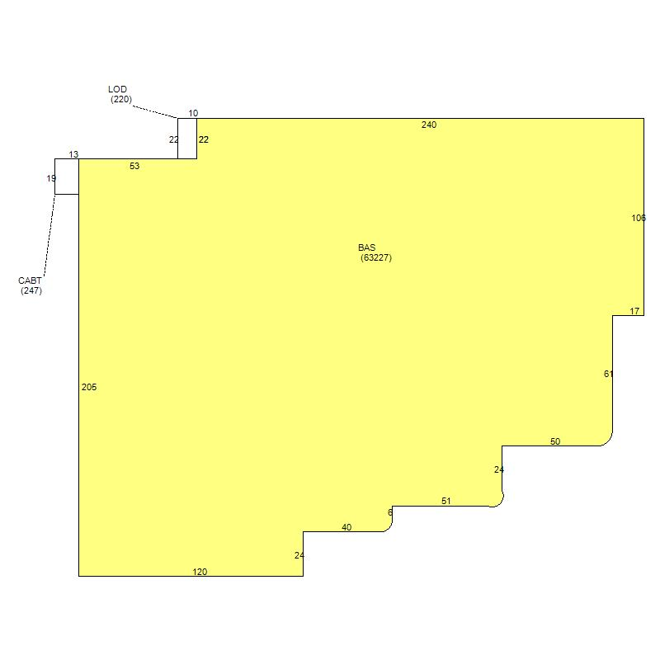
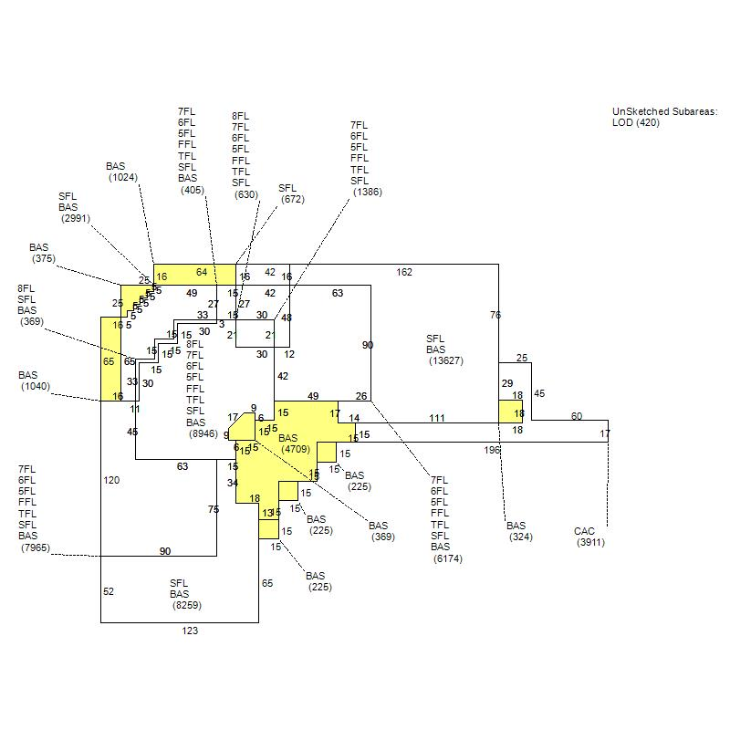
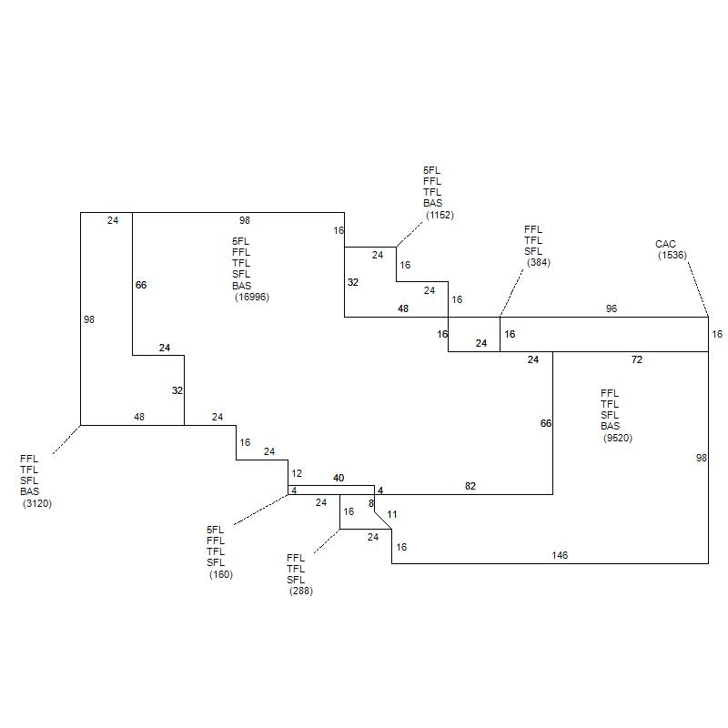
Tier 1 — Best Comparables — #1, #2, #3
Scores: 90-95/100
#1
636 Grassmere Park
#2
200 Athens Way
#3
210 Athens Way
Nashville, TN | Score: 95/100
Nashville, TN | Score: 93/100
Nashville, TN | Score: 90/100
$15,000,000 (2022)
$36,000,000 (2019)
$32,250,000 (2022)
Price/SF: $236.32/SF
Price/SF: $146.25/SF
Price/SF: $203.39/SF
Built 1985 | 6.02 ac | 1 stories
Built 1985 | 8.70 ac | 8 stories
Built 1985 | 10.01 ac | 5 stories
Zoning: IWD | Office (1-2 Stories)
Zoning: IWD | Office (3+ Stories)
Zoning: MUG-NS | Office (3+ Stories)
Building: 63,474 SF
Building: N/A
Building: N/A

Slide 4
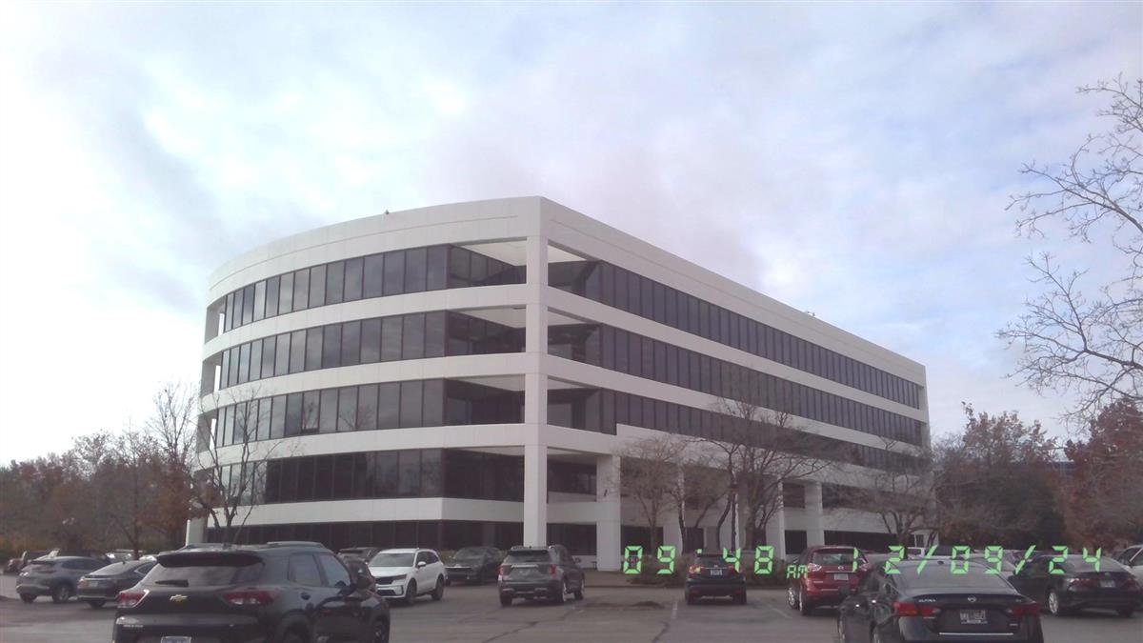
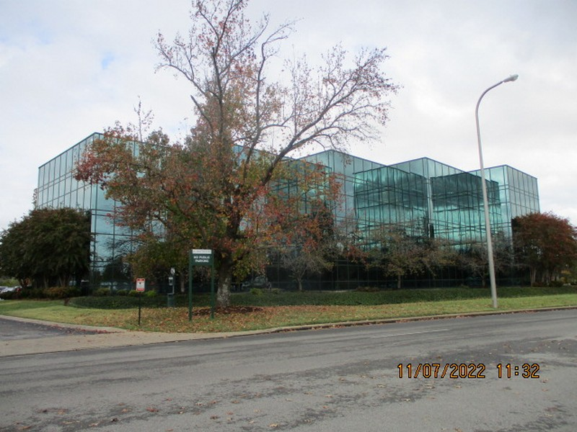
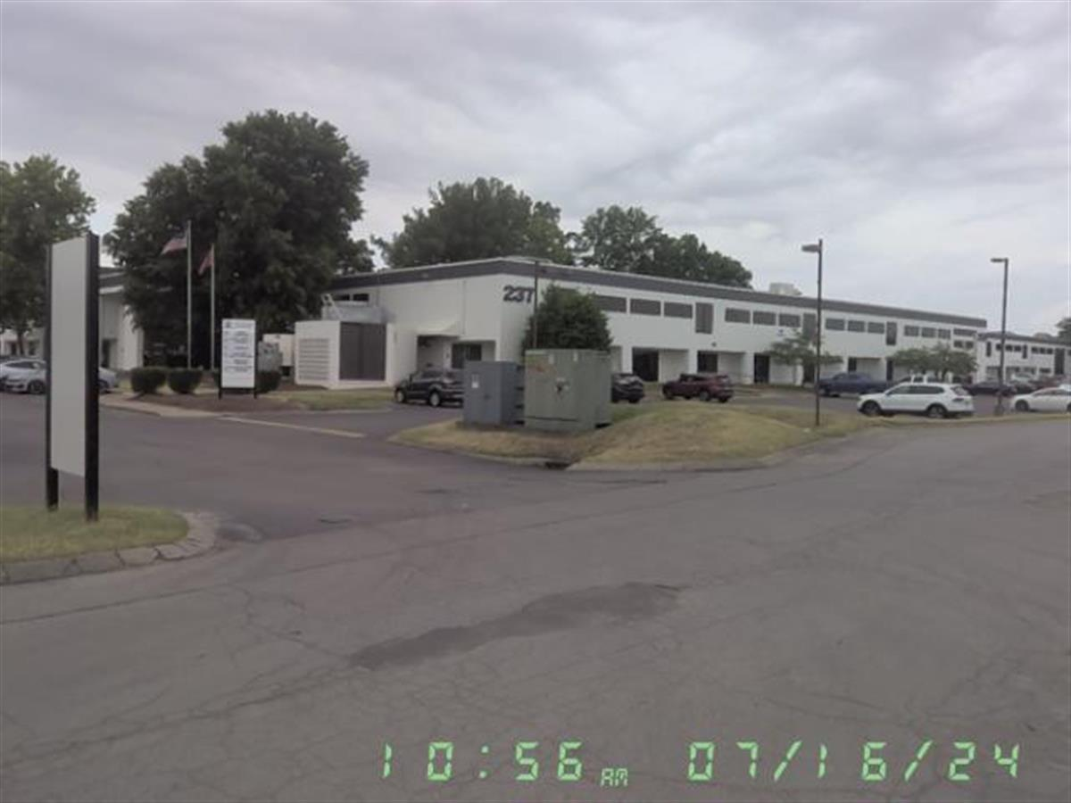
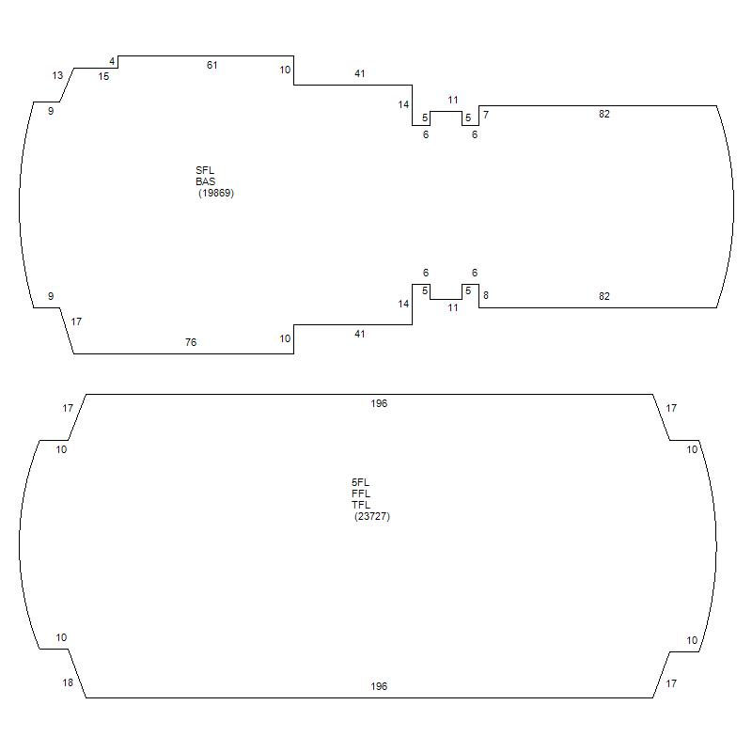
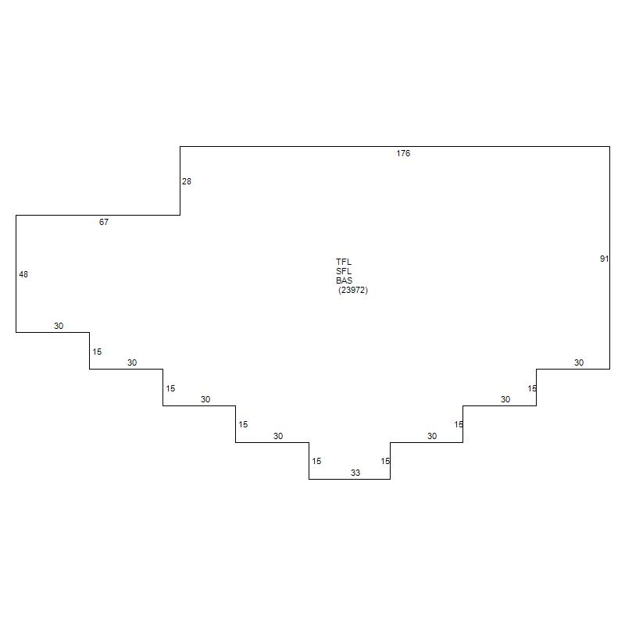
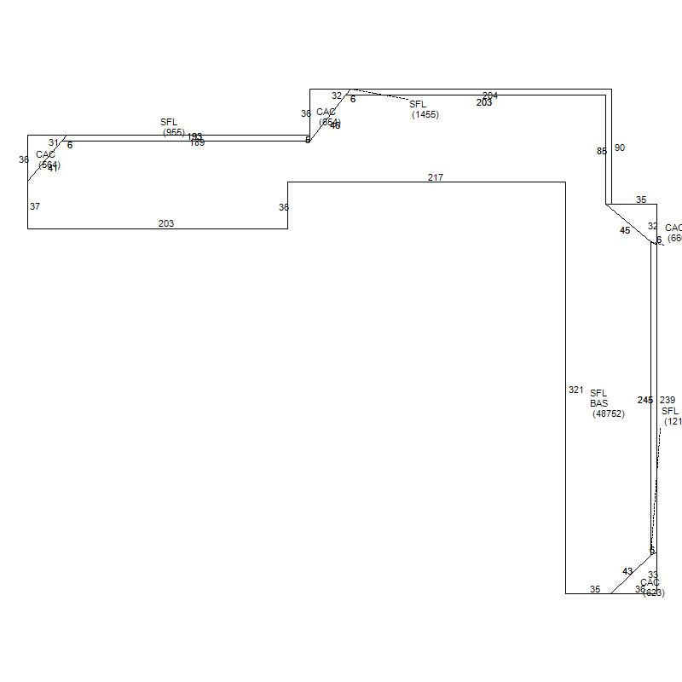
Tier 1 — Best Comparables — #4, #5, #6
Scores: 85-89/100
#4
227 French Landing Dr
#5
501 Great Circle Rd
#6
215 Cumberland Bnd
Nashville, TN | Score: 89/100
Nashville, TN | Score: 88/100
Nashville, TN | Score: 85/100
$22,350,000 (2019)
$18,000,000 (2019)
$10,850,000 (2020)
Price/SF: $201.50/SF
Price/SF: $143.08/SF
Price/SF: $107.29/SF
Built 1984 | 4.93 ac | 5 stories
Built 1985 | 6.22 ac | 3 stories
Built 1980 | 8.20 ac | 2 stories
Zoning: IWD | Office (3+ Stories)
Zoning: IWD | Office (3+ Stories)
Zoning: IWD | Office (1-2 Stories)
Building: N/A
Building: 71,916 SF
Building: N/A

Slide 5
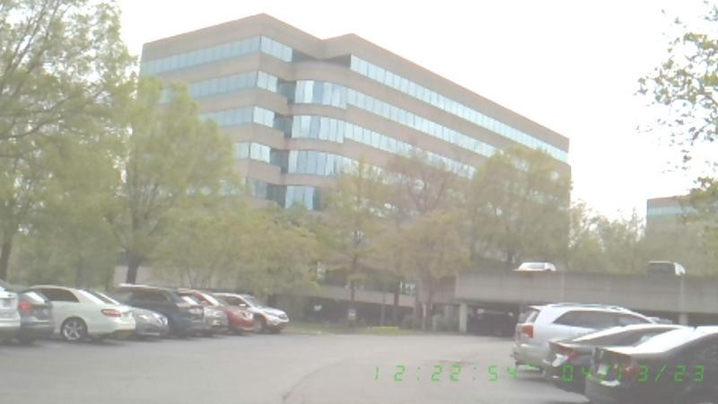
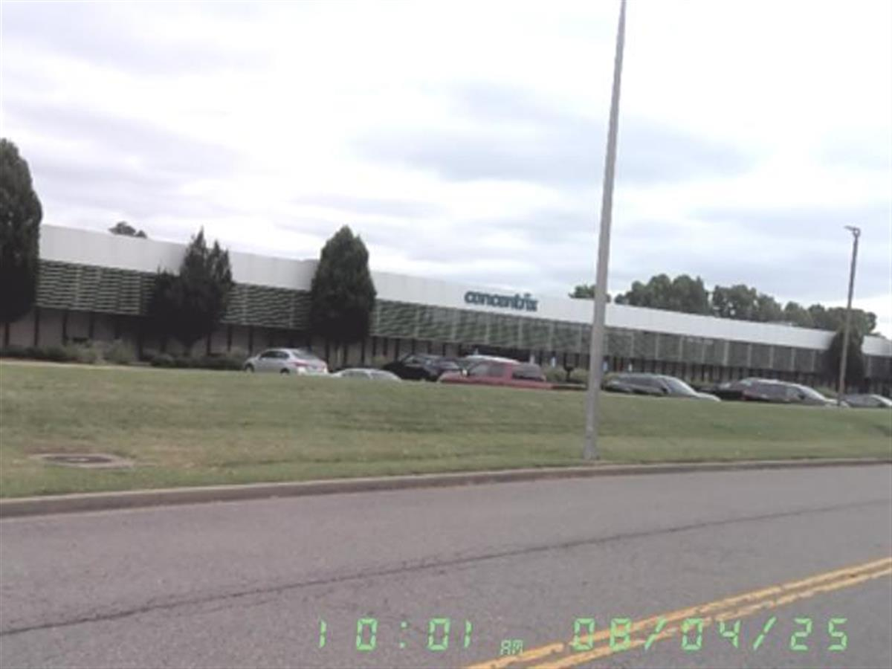
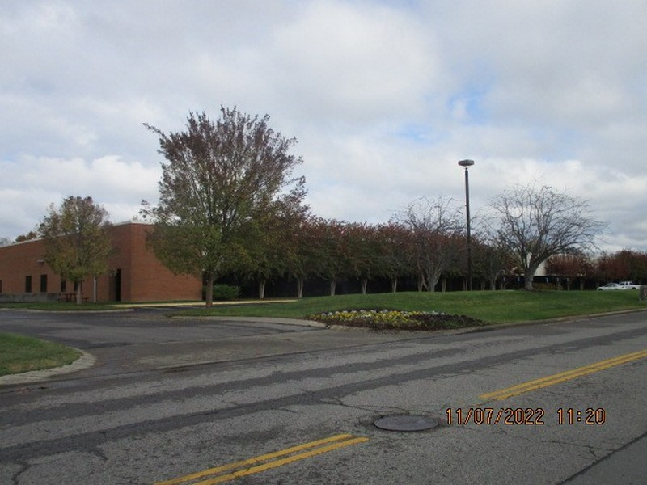
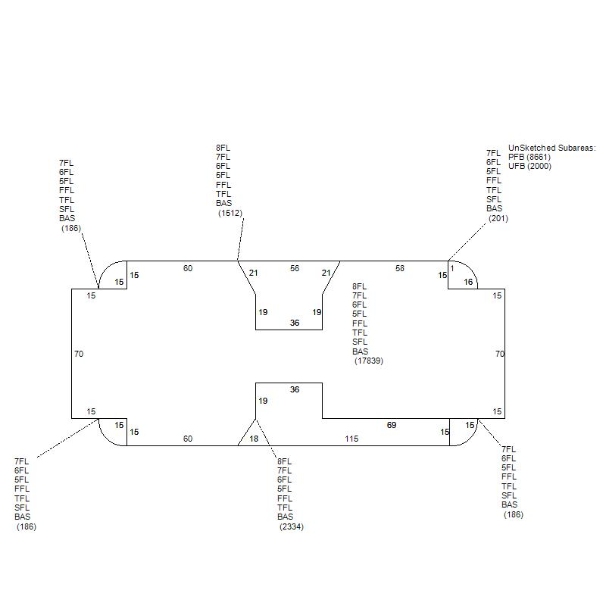
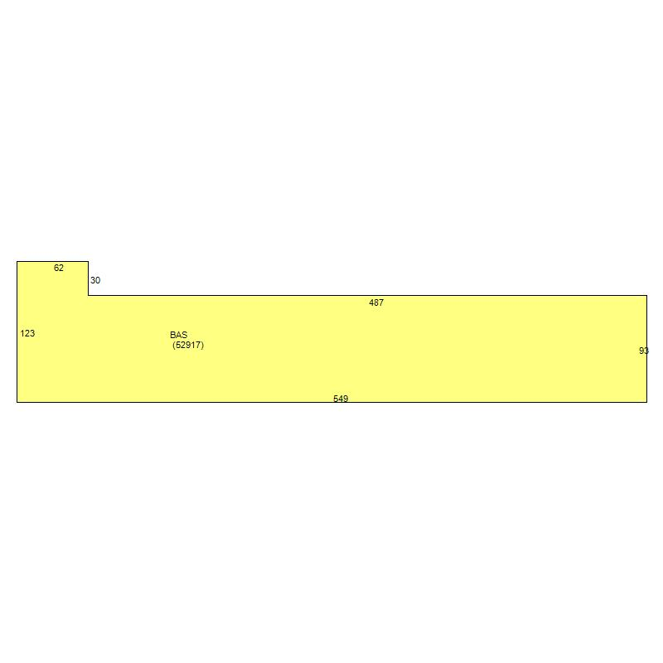
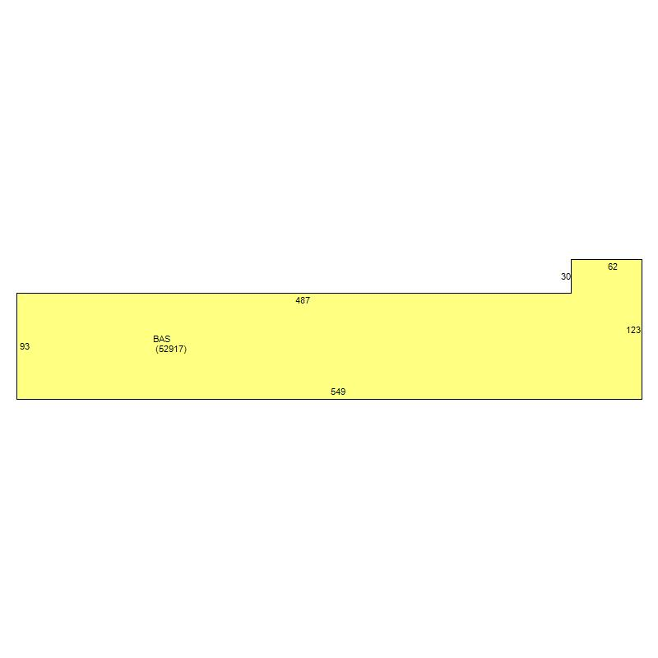
Tier 2 — Good Comparables — #7, #8, #9
Scores: 80-82/100
#7
545 Marriott Dr
#8
621 Mainstream Dr
#9
601 Mainstream Dr
Nashville, TN | Score: 82/100
Nashville, TN | Score: 80/100
Nashville, TN | Score: 80/100
$85,500,000 (2019)
$16,150,000 (2023)
$13,100,000 (2025)
Price/SF: $324.59/SF
Price/SF: $305.19/SF
Price/SF: $247.56/SF
Built 1986 | 8.60 ac | 8 stories
Built 1984 | 7.18 ac | 1 stories
Built 1984 | 7.18 ac | 1 stories
Zoning: ORI | Office (3+ Stories)
Zoning: IWD | Office (1-2 Stories)
Zoning: IWD | Office (1-2 Stories)
Building: N/A
Building: 52,917 SF
Building: 52,917 SF

Slide 6
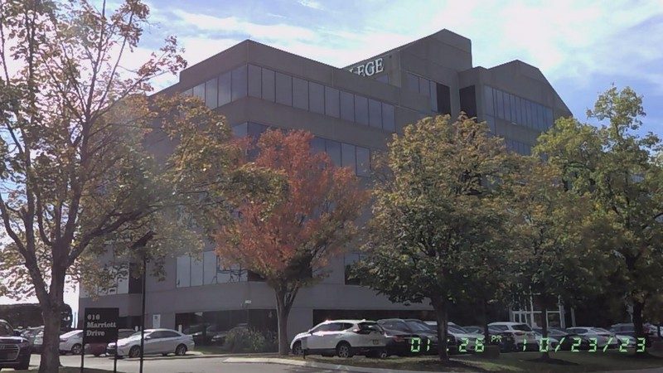
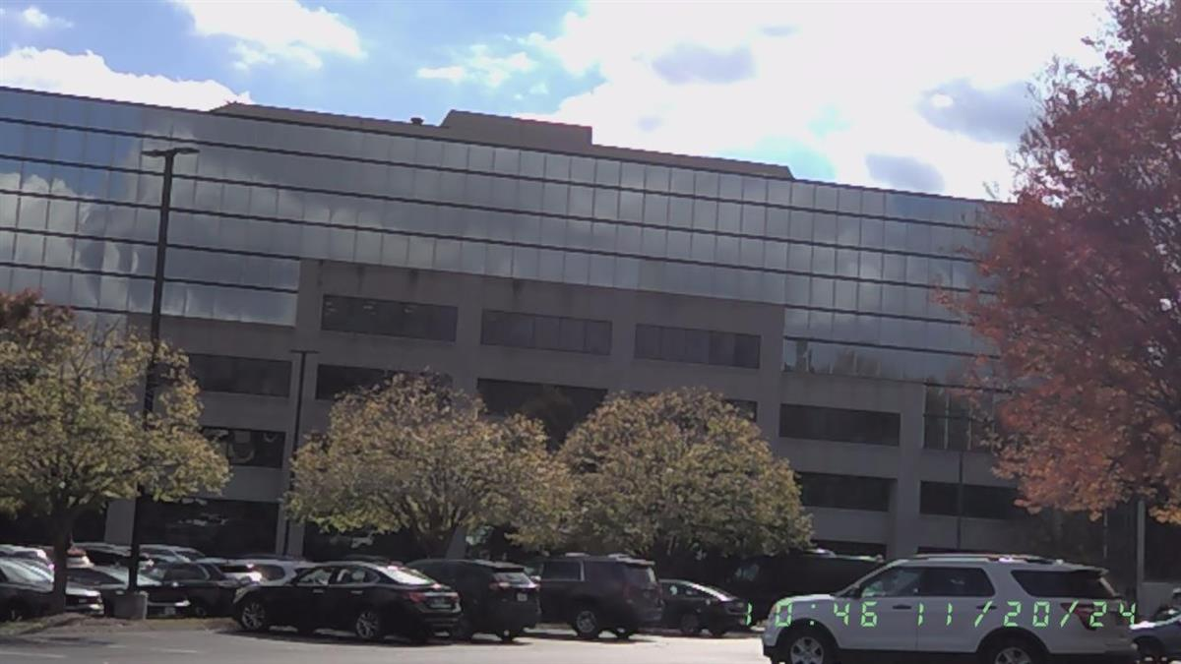
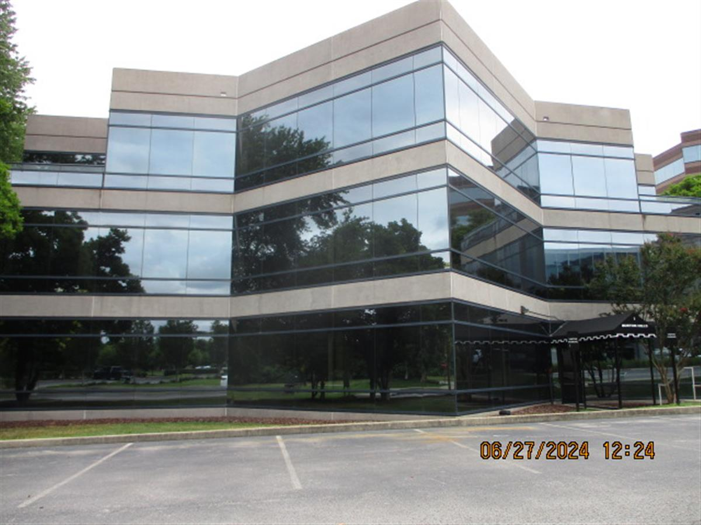
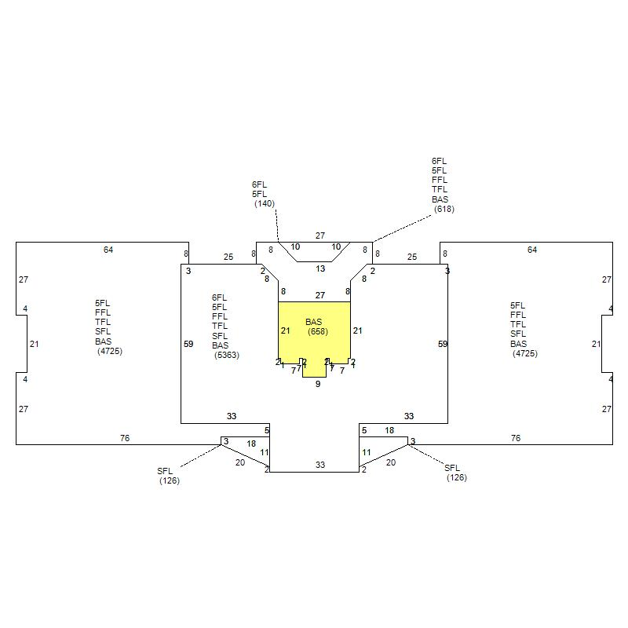
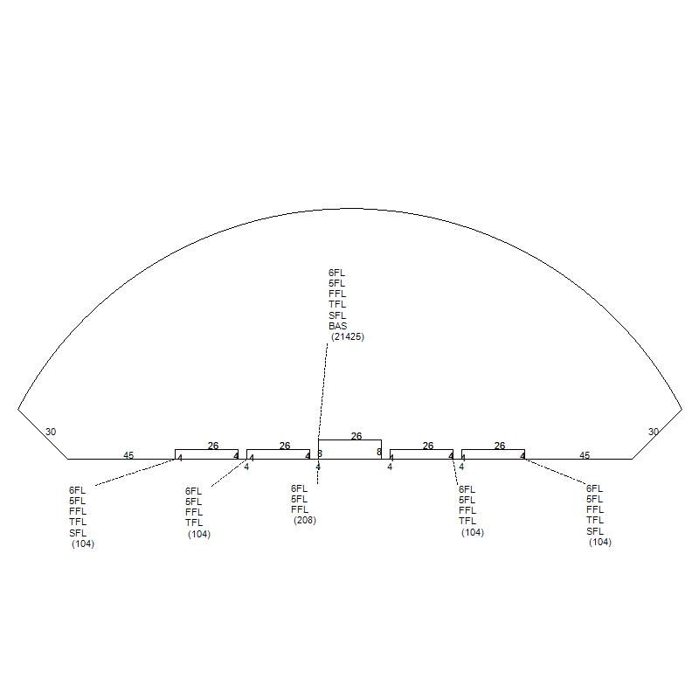
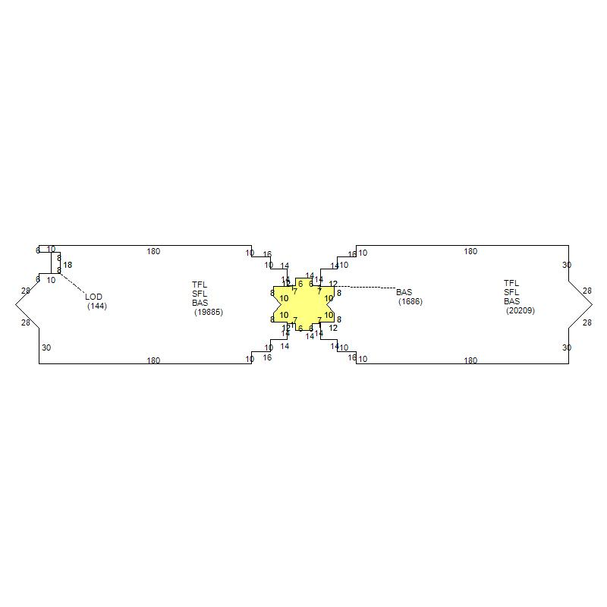
Tier 2 — Good Comparables — #10, #11, #12
Scores: 76-78/100
#10
616 Marriott Dr
#11
25 Century Blvd
#12
1 Burton Hills Blvd
Nashville, TN | Score: 78/100
Nashville, TN | Score: 77/100
Nashville, TN | Score: 76/100
$13,030,000 (2018)
$30,000,000 (2025)
$12,000,000 (2025)
Price/SF: $155.66/SF
Price/SF: $228.93/SF
Price/SF: $98.39/SF
Built 1985 | 3.74 ac | 6 stories
Built 1986 | 6.85 ac | 6 stories
Built 1985 | 7.07 ac | 3 stories
Zoning: ORI | Office (3+ Stories)
Zoning: ORI | Office (3+ Stories)
Zoning: SP | Office (3+ Stories)
Building: 83,708 SF
Building: N/A
Building: N/A

Slide 7
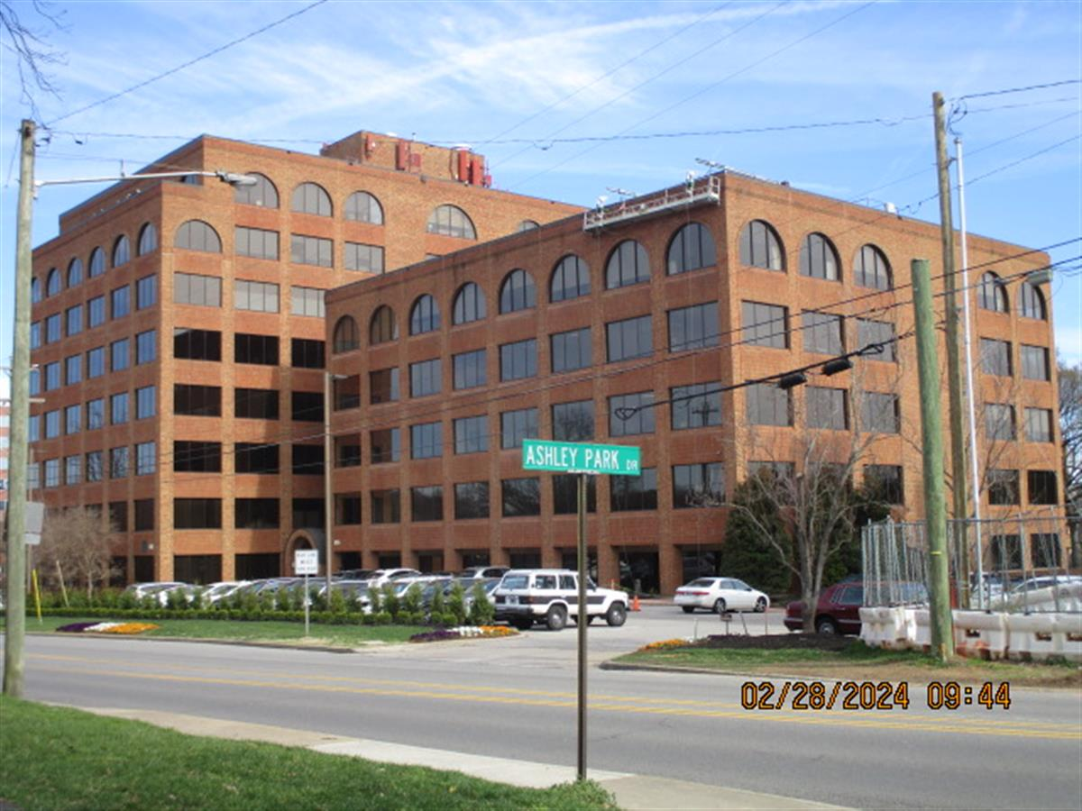
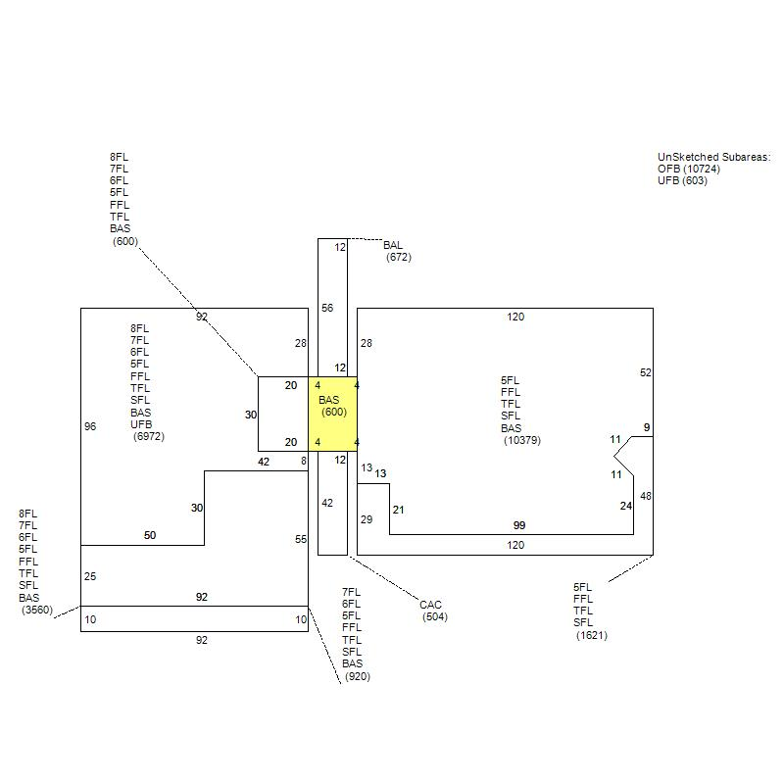
Tier 2 — Good Comparables — #13
Scores: 75-75/100
#13
104 Woodmont Blvd
Nashville, TN | Score: 75/100
$50,970,857 (2025)
Price/SF: $140.77/SF
Built 1985 | 2.40 ac | 8 stories
Zoning: OR20 | Office (3+ Stories)
Building: N/A

Slide 8
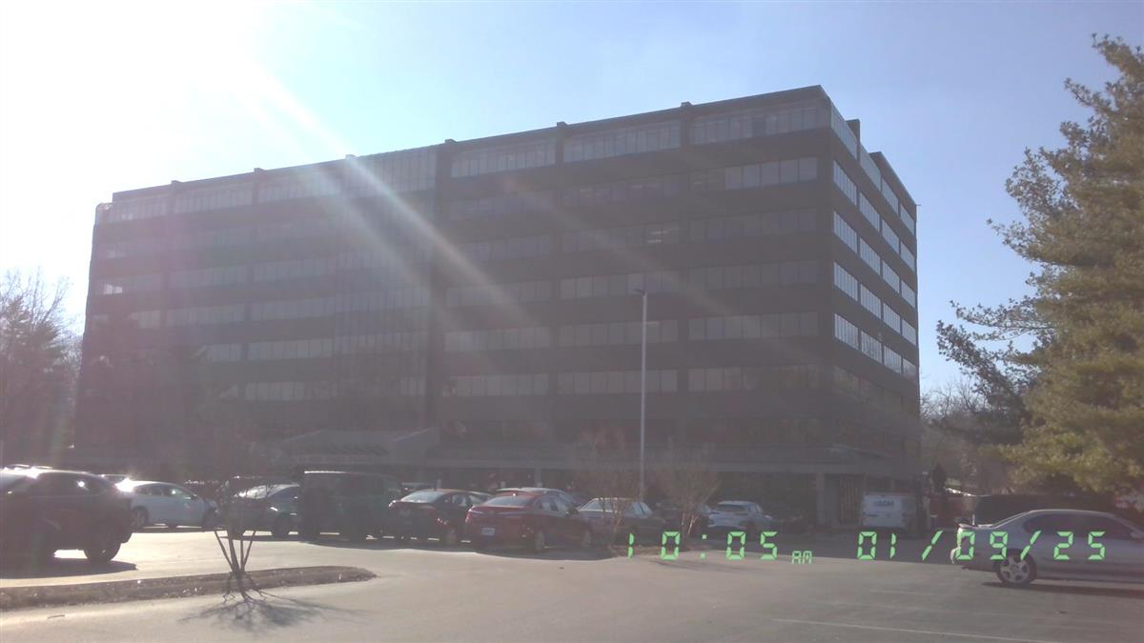
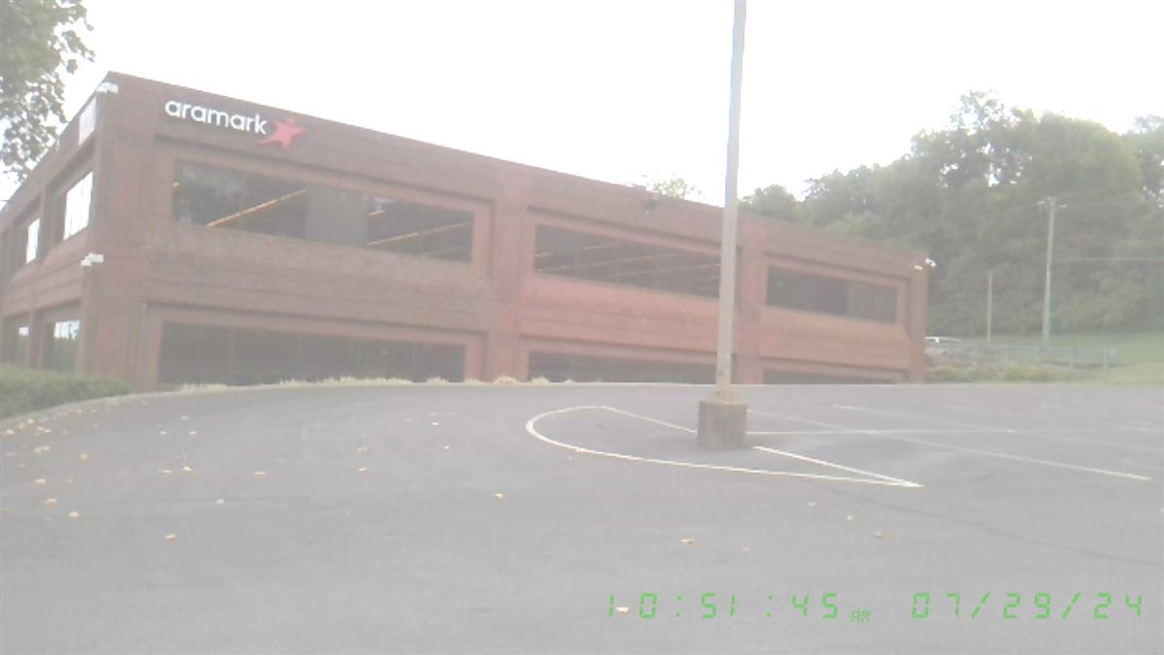
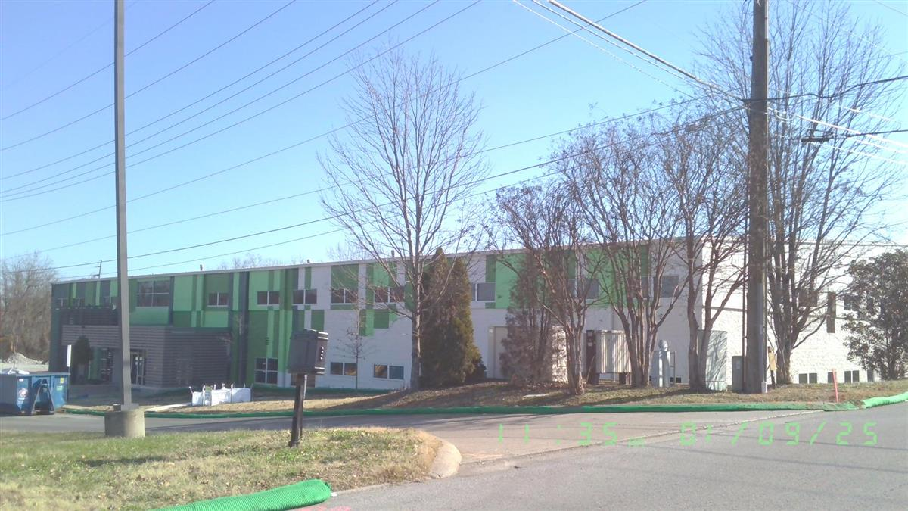
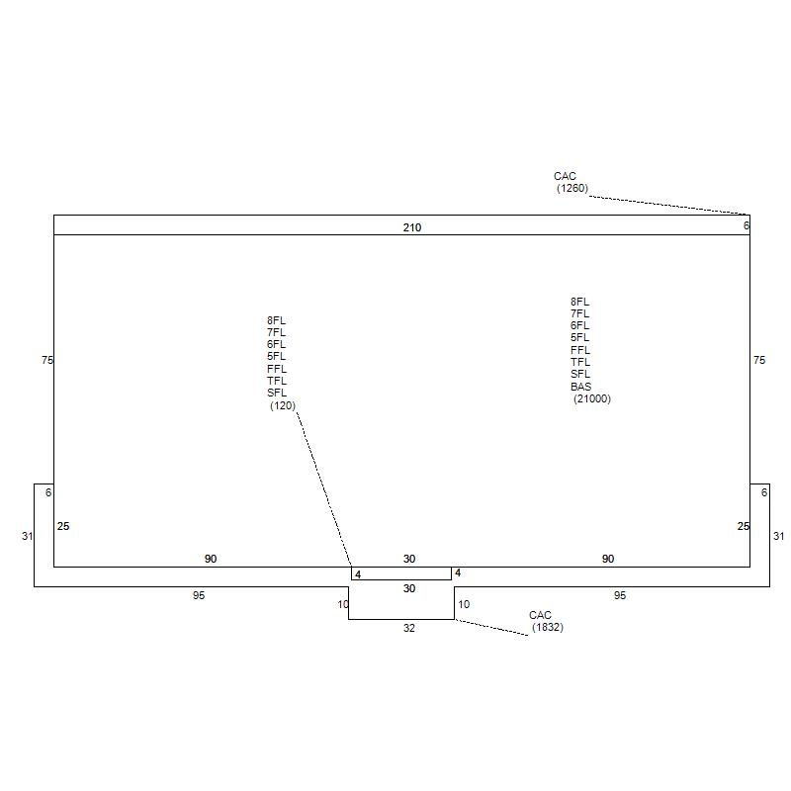
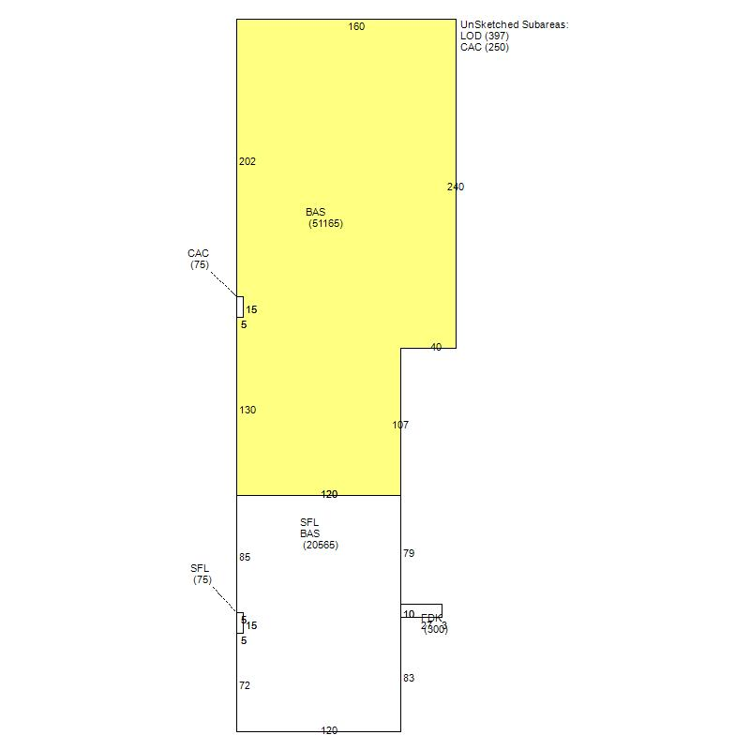
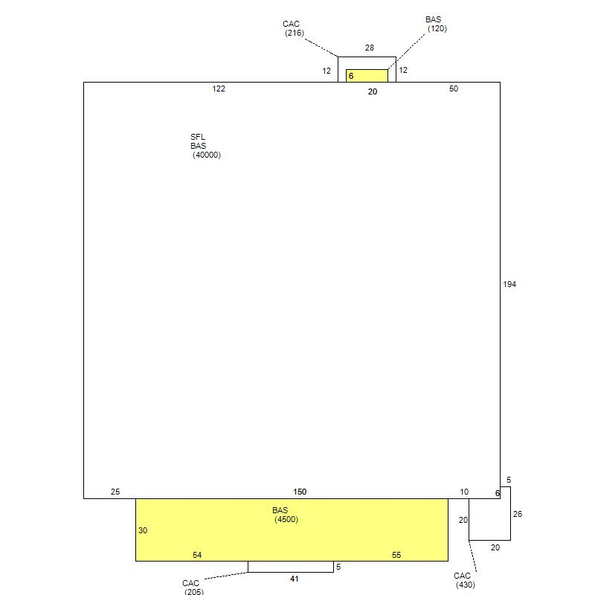
Tier 3 — Supporting Comparables — #14, #15, #16
Scores: 68-72/100
#14
1321 Murfreesboro Pike
#15
5880 Nolensville Pike
#16
490 Metroplex Dr
Nashville, TN | Score: 72/100
Nashville, TN | Score: 70/100
Nashville, TN | Score: 68/100
$18,500,000 (2021)
$17,000,000 (2019)
$11,000,000 (2024)
Price/SF: $97.45/SF
Price/SF: $184.04/SF
Price/SF: $129.99/SF
Built 1987 | 5.30 ac | 8 stories
Built 1989 | 13.80 ac | 2 stories
Built 1986 | 4.68 ac | 2 stories
Zoning: CL | Office (3+ Stories)
Zoning: R10 | Office (1-2 Stories)
Zoning: CS | Office (1-2 Stories)
Building: N/A
Building: 92,370 SF
Building: 84,620 SF

Slide 9
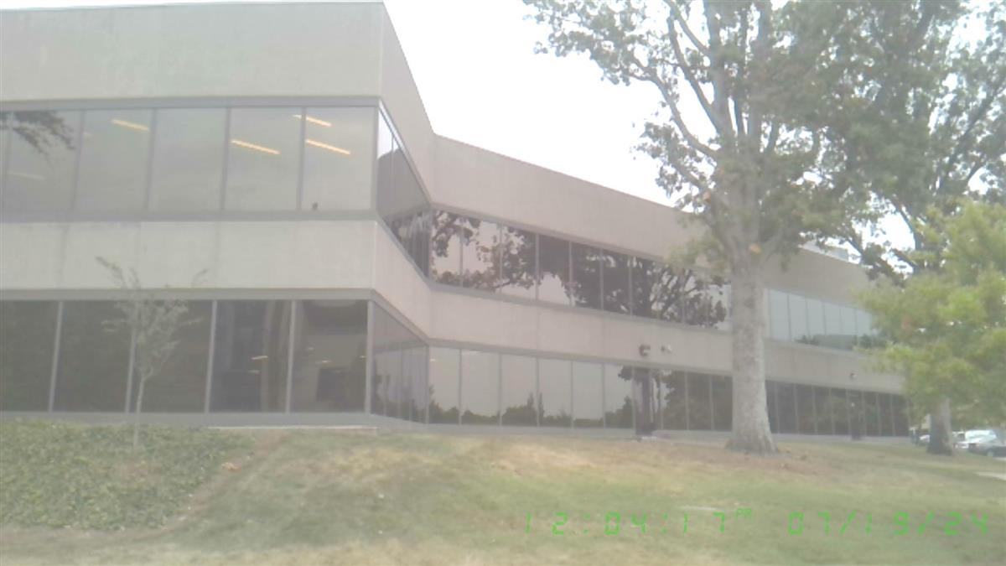
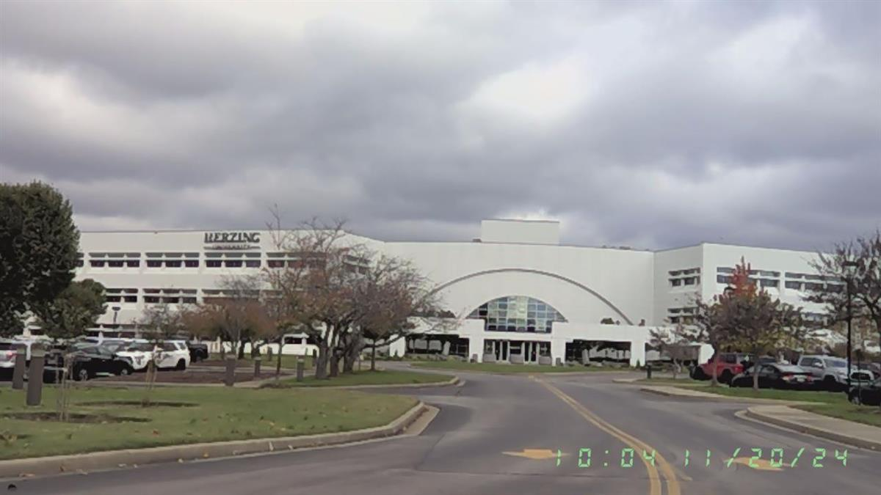
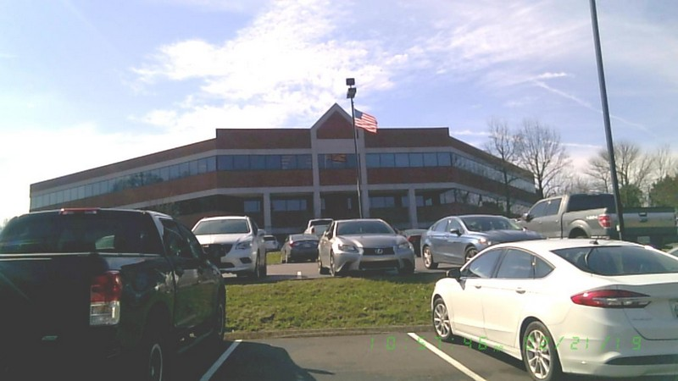
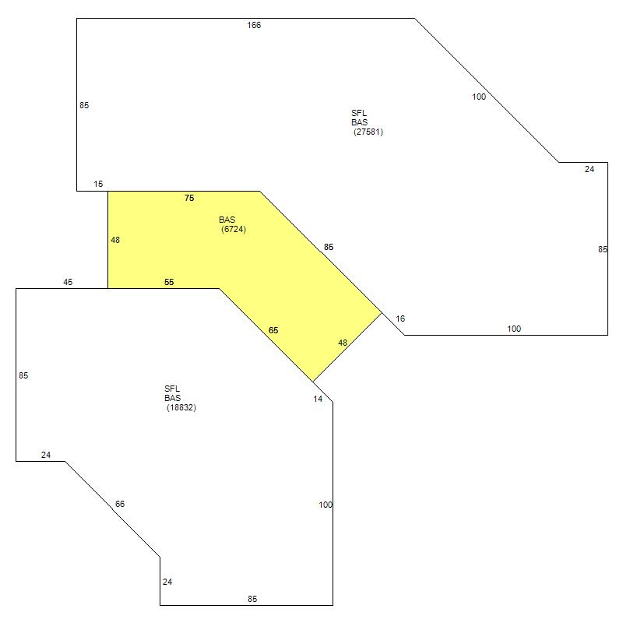
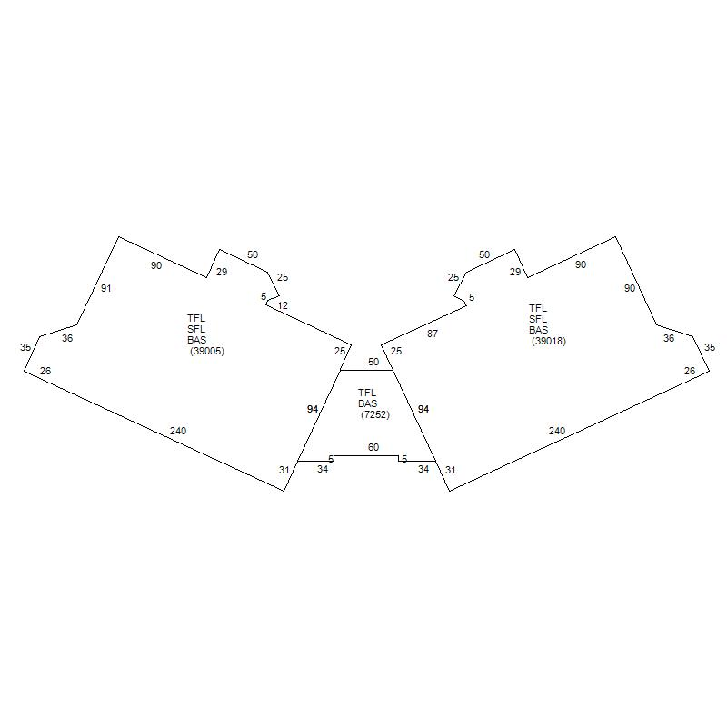
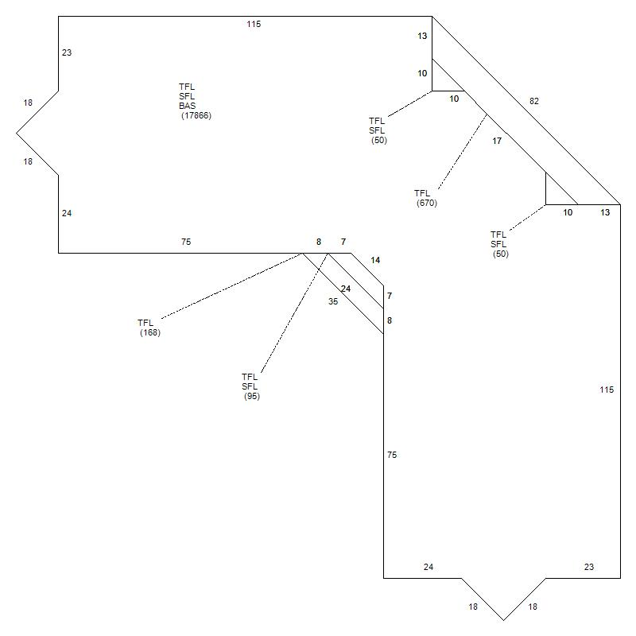
Tier 3 — Supporting Comparables — #17, #18, #19
Scores: 60-65/100
#17
750 Old Hickory Blvd
#18
100 Centerview Dr
#19
1000 Northchase Dr
Nashville, TN | Score: 65/100
Nashville, TN | Score: 63/100
Nashville, TN | Score: 60/100
$88,300,000 (2025)
$19,500,000 (2025)
$8,350,000 (2026)
Price/SF: $102.42/SF
Price/SF: $78.45/SF
Price/SF: $152.30/SF
Built 1983 | 14.50 ac | 2 stories
Built 1984 | 25.36 ac | 3 stories
Built 1988 | 3.18 ac | 3 stories
Zoning: OL | Office (1-2 Stories)
Zoning: OL | Office (3+ Stories)
Zoning: 6ZZ | Office (3+ Stories)
Building: 99,550 SF
Building: N/A
Building: 54,826 SF

Slide 10
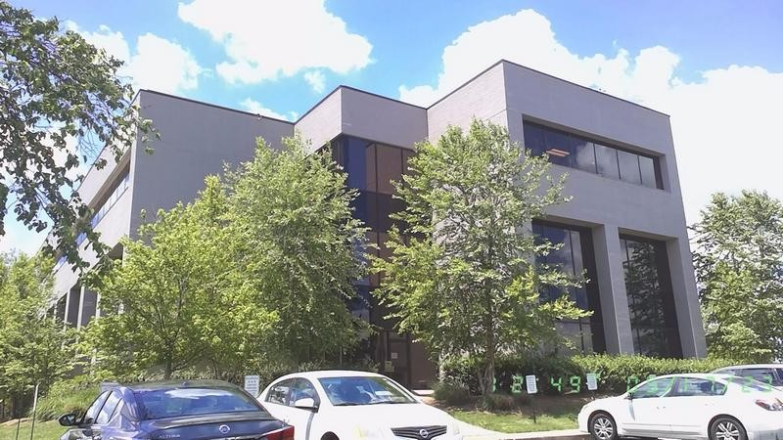
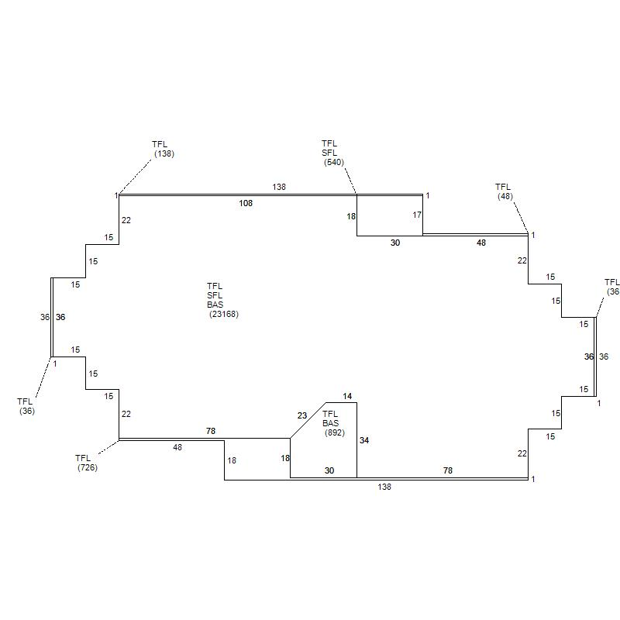
Tier 3 — Supporting Comparables — #20
Scores: 58-58/100
#20
3343 Perimeter Hill Dr
Nashville, TN | Score: 58/100
$5,254,600 (2018)
Price/SF: $71.64/SF
Built 1985 | 3.58 ac | 3 stories
Zoning: CS | Office (1-2 Stories)
Building: 73,352 SF

Slide 11
Comparable Sales Summary
648 Grassmere Park | 20 Comparable Properties | Davidson County, TN
Tier
Count
Price Range
Avg $/SF
Score Range
Subject
1
$25,938,000
$115.69
100
Tier 1 — Best
6
$10.9M - $36.0M
$107 - $236
85-95
Tier 2 — Good
7
$12.0M - $85.5M
$98 - $325
75-82
Tier 3 — Supporting
7
$5.3M - $88.3M
$72 - $184
58-72

Slide 12
Board of Zoning Appeals — Case History
Davidson County, Nashville, TN | 325 Total Cases (2006-2018)
325
Total BZA Cases
223
Expired
70
Completed
24
Withdrawn
5
Approved to Pay
1
Granted
Top Case Subtypes
Case Subtype
Count
Zoning Board Appeal / Religious Institution, ...
33
Zoning Board Appeal / Day Care Home, Single F...
8
Zoning Board Appeal / Zoning Appeal...
7
Zoning Board Appeal / Kennel / Stable, Kennel...
6
Zoning Board Appeal / Day Care Center (Up To ...
6
Zoning Board Appeal / Master Permit Applicati...
5
Zoning Board Appeal / Religious Institution, ...
5
Zoning Board Appeal / Multifamily, Condominiu...
4
Status Breakdown
EXPIRED: 223 (69%)
Done: 70 (22%)
Withdrawn: 24 (7%)
OK to Pay Permit Fee: 5 (2%)
Cancelled: 1 (0%)
Payment was refunded/permit cancelled: 1 (0%)
GRANTED: 1 (0%)

Slide 13
Office Building Permit History — Davidson County
General Office, Professional Services | 8,291 Total Permits (2006-2025)
8,291
Total Permits
$5.17B
Total Const. Value
$894K
Avg Const. Value
6,475
Completed (78%)
1,447
Expired (17%)
Permit Type Breakdown
Type
Count
Rehab
6,001
Tenant Finish Out
955
New
394
Use & Occupancy
379
Addition
221
Commercial Rehab Storm Damage
97
Shell
96
Foundation
60
Key Insights
Peak activity: 2015 (539 permits), 2016 (508)
Highest construction value: 2022 ($597M)
Rehab permits dominate (72% of all permits)
New construction: 394 permits (5% of total)
Consistent ~400-500 permits/year since 2010

Slide 14
Office Construction Value Trends
Total Construction Value by Year | Davidson County, Nashville, TN
Construction Value Highlights
$187M
2007
Early boom period
$348M
2015
Post-recession surge
$410M
2017
Peak pre-COVID
$531M
2018
Record high
$475M
2020
Resilience through COVID
$597M
2022
All-time record

Slide 15
Nashville Office Sales — Market Overview
Davidson County | 14,841 Office Properties | 8,207 Recorded Sales
14,841
Office Properties
8,207
Recorded Sales
$17.8B
Total Volume
$2.2M
Avg Sale Price
$240K
Median Sale
2,020
Total Buildings
Sales by Office Type
Type
Sales
Avg Price
Median
Office (1-2 Story)
6,210
$1.1M avg
$190K med
Office (3+ Story)
836
$11.3M avg
$2.3M med
Medical (1-2 Story)
1,054
$933K avg
$253K med
Medical (3+ Story)
107
$2.2M avg
$214K med
648 Grassmere Park — Market Position
Overall Market Rank: #84 of 2,020 buildings
95.8th percentile by appraised value
3+ Story Office Rank: #63 of 213
IWD Zone Rank: #4 of 153
Sale Price: $25.9M (2015) at $115.69/SF
Total Appraised: $37.4M (current)

Slide 16
Office Sales Price Trends — $/SF Over Time
Davidson County | Median & Average Price Per Square Foot | 2005-2025
Office Sales Data by Year
Year
Sales
Total Volume
Avg Price
Med $/SF
2005
196
$1719M
$8.8M
$78
2008
132
$279M
$2.1M
$89
2010
67
$35M
$0.5M
$87
2013
133
$414M
$3.1M
$111
2015
192
$598M
$3.1M
$136
2017
168
$800M
$4.8M
$182
2018
150
$925M
$6.2M
$178
2019
142
$1129M
$8.0M
$222
2020
119
$740M
$6.2M
$217
2021
157
$960M
$6.1M
$322
2022
112
$1564M
$14.0M
$394
2023
98
$379M
$3.9M
$386
2024
81
$311M
$3.8M
$335
2025
87
$1170M
$13.5M
$322
Key Takeaways
Median $/SF grew 4x from $78/SF (2005) to $322/SF (2025)
Peak transaction volume: $1.56B in 2022
2019 was the high-water mark for avg price ($7.95M)
Post-COVID recovery strong: 2021-2022 saw record values
Transaction count declined from 200/yr to ~90/yr (flight to quality)
648 Grassmere at $115.69/SF sold below 2015 median of $136/SF

